Slide 1
INTERCONNECTIVITY- AN INTRODUCTION TO ARDUINO CONTROLLER
UNIT 2
18AIS102J - SMART MANUFACTURING

Slide 2
Introduction
Arduino is made up of both hardware and software.
The Arduino board is a printed circuit board (PCB) designed to use a microcontroller chip as well as other input and outputs.
The board has many other electronic components that are needed for the microcontroller to function or to extend its capabilities.
John Nussey - Arduino for Dummies (2018)

Slide 3
Introduction - Micro controllers
A microcontroller is a small computer contained in a single, integrated circuit or computer chip.
Microcontrollers are an excellent way to program and control electronics.
Microcontroller boards have a microcontroller chip and other useful connectors and components that allow a user to attach inputs and outputs.
John Nussey - Arduino for Dummies (2018)

Slide 4


Arduino - Historical Bytes
Arduino started its life in Italy, at Interaction Design Institute Ivrea (IDII), a graduate school for interaction design that focuses on how people interact with digital products, systems, and environments and how they in turn influence us.
John Nussey - Arduino for Dummies (2018)

Slide 5


Arduino - Historical Bytes
The term interaction design was coined by Bill Verplank and Bill Moggridge in the mid-1980s.
Bill Verplank
John Nussey - Arduino for Dummies (2018)

Slide 6
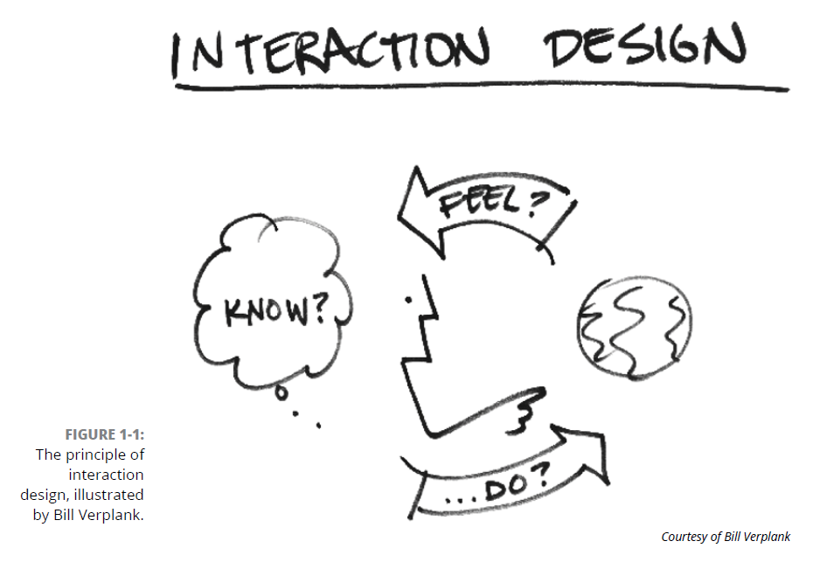
Arduino - Historical Bytes
The sketch by Verplank illustrates the basic premise of interaction design: If you do something, you feel a change, and from that you can know something about the world.
John Nussey - Arduino for Dummies (2018)

Slide 7
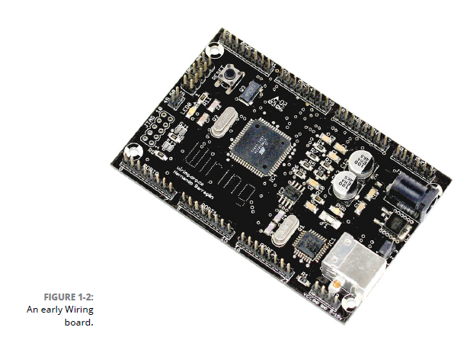
Arduino - Historical Bytes
2001 - Processing - by Casey Reas and Benjamin Fry - aimed to get non-programmers into programming by making it quick and easy to produce on-screen visualizations and graphics.
2003 - Wiring Board - Hernando Barragán - designed to get people into electronics as well as programming.
Both were expensive to students. [fragile]
John Nussey - Arduino for Dummies (2018)

Slide 8
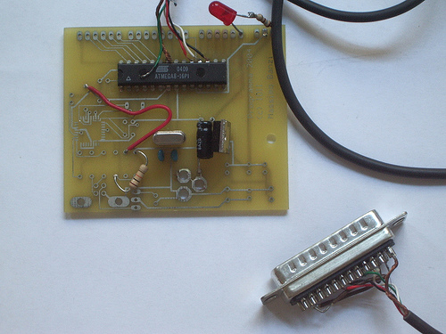
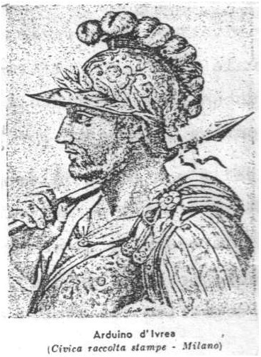
Arduino - Historical Bytes
2005 - Arduino - Massimo Banzi and David Cuartielles - named after an Italian bar named after King Arduin of Italy.
The very first type of Arduino
John Nussey - Arduino for Dummies (2018)

Slide 9
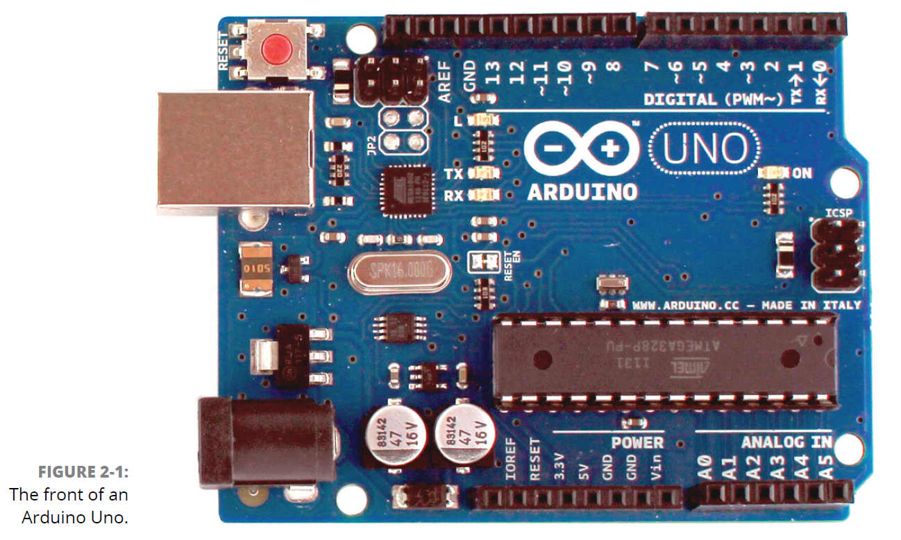
The front
Introduction

Slide 10
Arduino - Hardware
Arduino Uno is a microcontroller board based on the ATmega328P .
It has 14 digital input/output pins (of which 6 can be used as PWM outputs), 6 analog inputs
a 16 MHz ceramic resonator (CSTCE16M0V53-R0), a USB connection, a power jack, an ICSP header and a reset button.
Connect it to a computer with a USB cable or power it with a AC-to-DC adapter or battery.

Slide 11
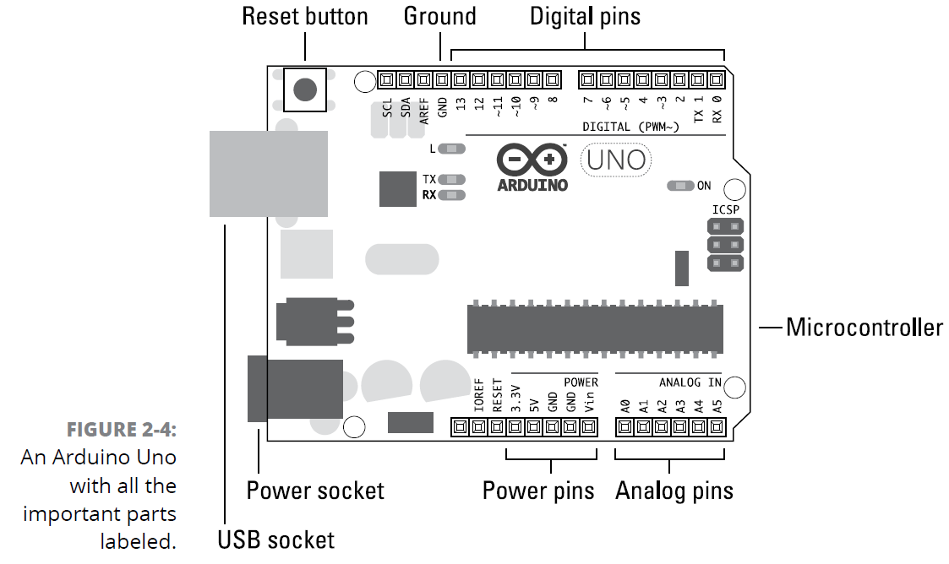
Arduino - Features
Microcontroller: ATmega328P
32 KB of Flash memory
Operating Voltage: 5V
Input Voltage (recommended): 7-12V
Input Voltage (limits): 6-20V
Digital I/O Pins: 14 (6 pins provide PWM output)
Analog Input Pins: 6
DC Current per I/O Pin: 40 mA
DC Current for 3.3V Pin: 50 mA.

Slide 12
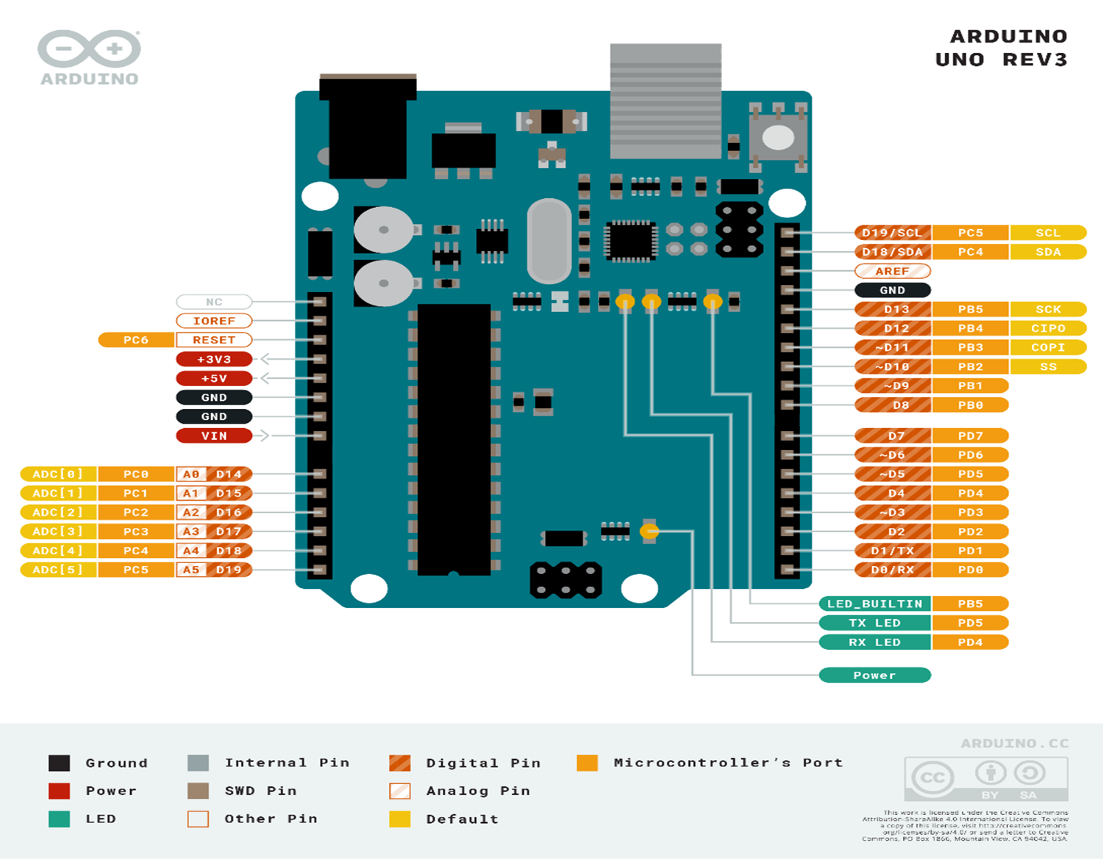

Slide 13
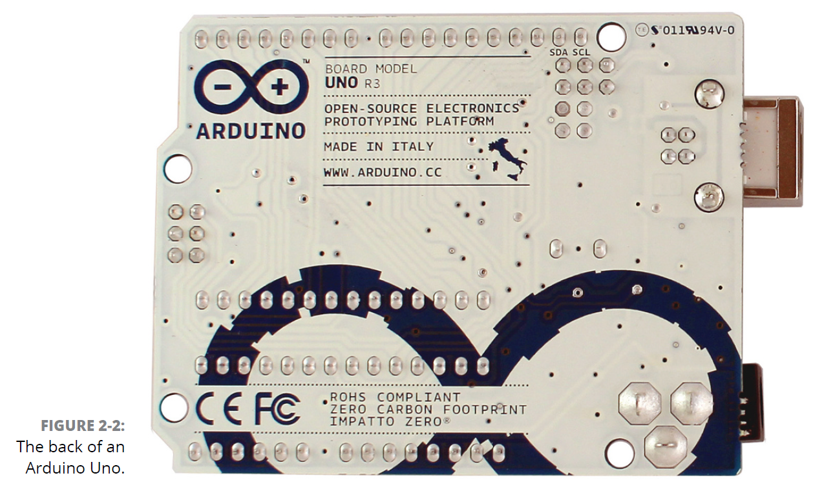
The back

Slide 14
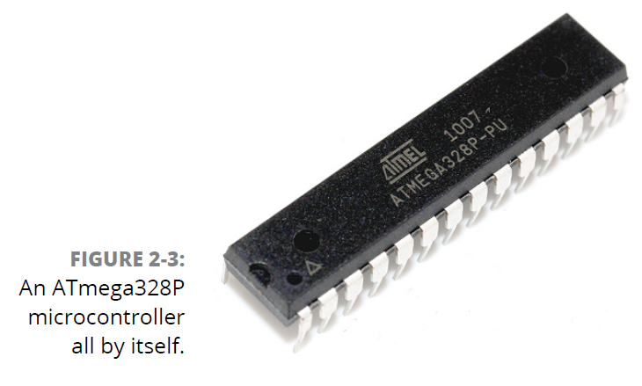
The Brains: ATmega328P microcontroller chip
The chip used in the Arduino Uno is the ATmega328P, made by Atmel.
It’s the large, black component in the center of the board.
This chip is known as an integrated circuit, or IC.
It sits in a socket

Slide 15
ATmega328P
This same chip can come in different forms, referred to as packages.
The one in an Arduino Uno is in a plated-through hole, or PTH, package, named because of the way it makes contact with the board.
Another variation you may find is the Arduino Uno SMD, or surface mount device, package, which is mounted on the surface of the board rather than in holes that go through it.
This chip is much smaller, but it is not replaceable, whereas the PTH chip is.
Apart from that, it functions exactly the same as the PTH and differs only in looks.

Slide 16
ATmega328P - Header sockets
The microcontroller socket connects all the legs of the ATmega328 microcontroller chip to other sockets, referred to as header sockets, which are arranged around the edge of the board and are labeled for ease of use.
These black sockets are divided into three main groups:
digital pins,
analog input pins, and
power pins.
All these pins transfer a voltage, which can be either sent as output or received as an input.

Slide 17
ATmega328P - Pins
They allow you to connect additional circuitry to the board quickly and easily when prototyping with a breadboard and to design additional boards, called shields, that fit neatly on top of the Arduino board.
It is difficult to directly link a computer accustomed to digital signals (0s and 1s) to an electronic circuit that deals with a range of voltages (0v to 5v in the ATmega328P’s case).
The Arduino is special because it can interpret these electric signals and convert them to digital signals that your computer can understand — and vice versa.
It also enables you to write a program using software on a conventional computer that the Arduino IDE (integrated development environment) converts or compiles to electrical signals that your circuit can understand.

Slide 18
ATmega328P - Pins
Digital pins
Digital pins are used to send and receive digital signals. Digital implies that the pins have two states: off or on. In electrical terms, these states translate to a value of 0 or 5 volts, but no values in between.
Analog in pins
Analog in pins are used to receive an analog value. An analog value is taken from a range of values. In this case, the range is the same 0V to 5V as with the digital pins, but the value can be at any point — 0.1, 0.2, 0.3, and so on.

Slide 19
ATmega328P - PinOuts
Arduino UNO has 20 input/output pins.
Among these 20 pins, we have 14 digital pins.
The remaining 6 pins are analog pins.
It also has 6 PWM pins which are used for Pulse Width Modulation.
Arduino UNO supports follow 3 communication protocols:
Serial Protocol
I2C Protocol [Inter-Integrated Circuits]
SPI Protocol [Serial Peripheral Interface or SPI is a synchronous serial communication protocol that provides full – duplex communication at very high speeds. Serial Peripheral Interface (SPI) is a master – slave type protocol that provides a simple and low cost interface between a microcontroller and its peripherals.]

Slide 20
Timers in ARDUINO
https://www.youtube.com/watch?v=Uv9UeYUsA8A

Slide 21
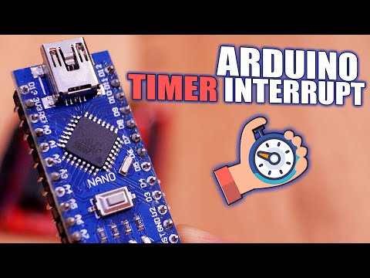

Slide 22
Timer Basics
A timer (sometimes referred to as a counter) is a special piece of hardware inside many microcontrollers. Their function is simple: they count (up or down, depending on the configuration.) For example, an 8-bit timer will count from 0 to 255. Most timers will “roll over” once they reach their max value. So, an 8-bit timer would start over again from 0 once it reaches 255.
One can apply a variety of settings to most timers to change the way they function. These settings are usually applied via other special function registers inside the microcontroller. For example, instead of counting to a maximum of 255, you might tell the timer that you want it to roll over at 100 instead. Additionally, you can often connect other hardware or peripherals inside the microcontroller to the timer, like toggling a specific pin automatically when the timer rolls over.

Slide 23
Timers
Here are some of the common hardware functions you’ll see with timers:
Output compare (OC): toggle a pin when a timer reaches a certain value
Input capture (IC): measure the number of counts of a timer between events on a pin
Pulse width modulation (PWM): toggle a pin when a timer reaches a certain value and on rollover. By adjusting the on versus off time (duty cycle), you can effectively control the amount of electrical power going to another device.

Slide 24
Timers - Pre Scalar
How fast do timers run? Well, that depends on how fast you tell them to run. All timers require a clock of some sort. Most will be connected to the microcontroller’s main CPU clock (others, like real time clocks, have their own clock sources). A timer will tick (increment by one) each time it receives a clock pulse.
In this example, an STM32 Nucleo-L476RG, which has a default main clock (HCLK) of 80 MHz has been used. We could have a timer tick at 80 MHz, but that might be too fast for many of our applications. A 16-bit timer can count to 65,535 before rolling over, which means we can measure events no longer than about 819 microseconds!

Slide 25
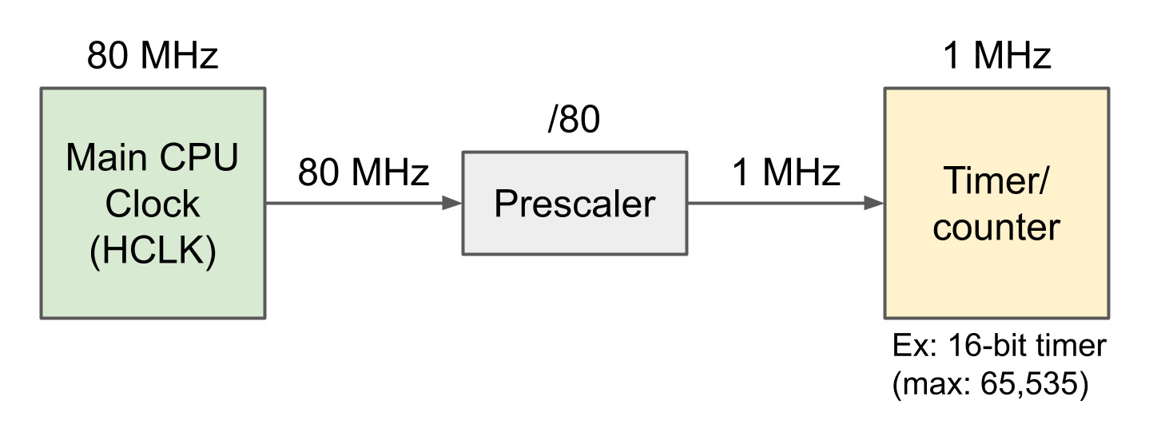
Timers - Pre Scalar
If we wish to measure longer events, we need to use a prescaler, which is a piece of hardware that divides the clock source. For example, a prescaler of 80 would turn an 80 MHz clock into a 1 MHz clock.
Now, our timer would tick once every 1 microsecond and, assuming a 16-bit timer, be able to time events up to a maximum of about 65.5 milliseconds.

Slide 26
Timers
•Arduino is an open-source prototyping platform - it comes with software and a development board. Whereas Atmega328P is a microcontroller.
•The Atmega328P has a total of three timer/counters named Timer/counter 0, Timer/counter 1, and Timer/counter 2.
•The first and last of these are both 8-bit timer/counters and have a maximum value of 255, while Timer/Counter 1 is 16 bits and its maximum is 65,535

Slide 27
Timers
•TIMER 0
8 BIT TIMER /COUNTER WITH PRESCALE
•TIMER 1
16 BIT TIMER /COUNTER WITH PRESCALE
•TIMER 2
8 BIT TIMER ONLY WITH PRESCALE AND POSTSCALE

Slide 28
Timer 0
•READABLE/WRITEABLE
•8 BIT PROGRAMMABLE PRESCALAR
•INTERNAL OR EXTERNAL CLOCK SET
•EDGE SELECT FOR EXTERNAL CLOCK
•INTERRUPT OVERFLOW FROM 00 TO FF( hexadecimal for 255)
•REGISTER- OPTION,TMR0,INTCON

Slide 29
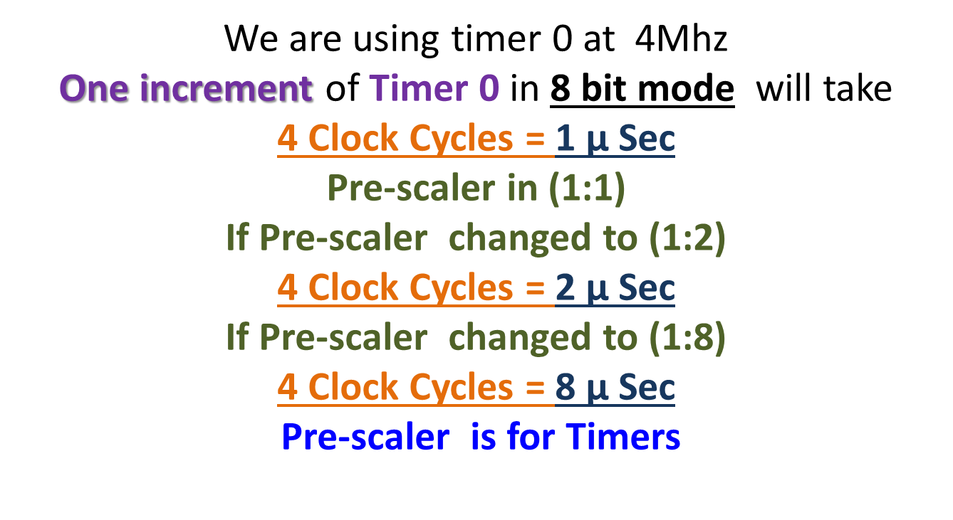
Timer 0

Slide 30
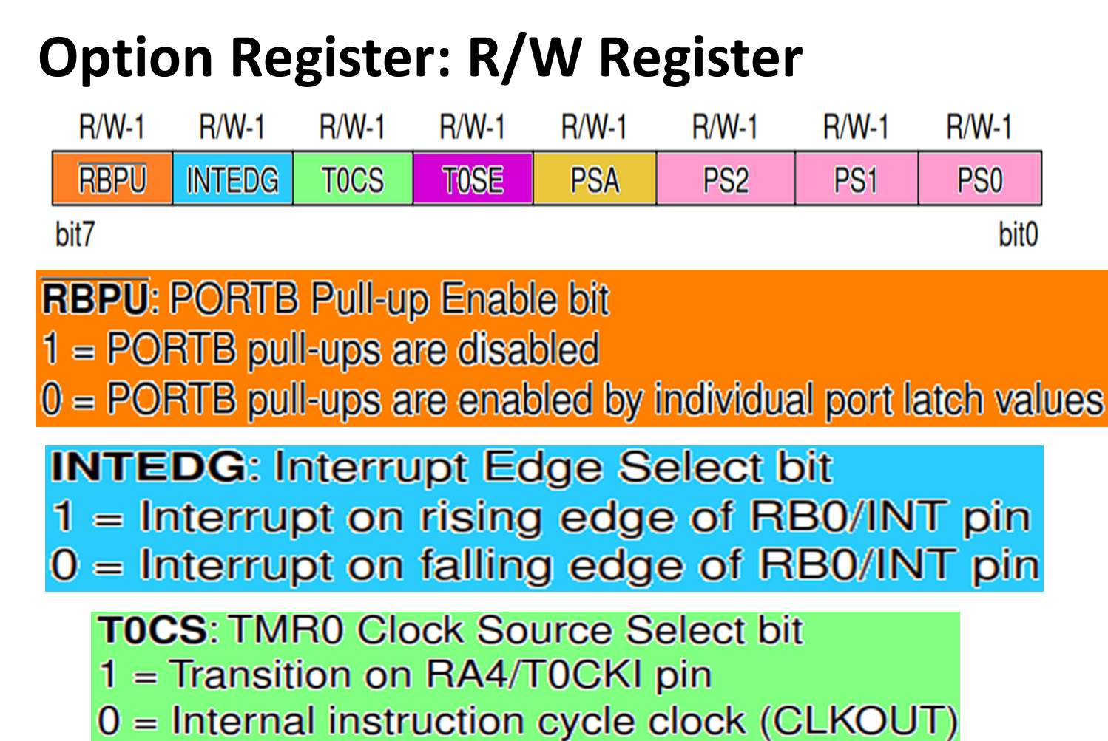

Slide 31
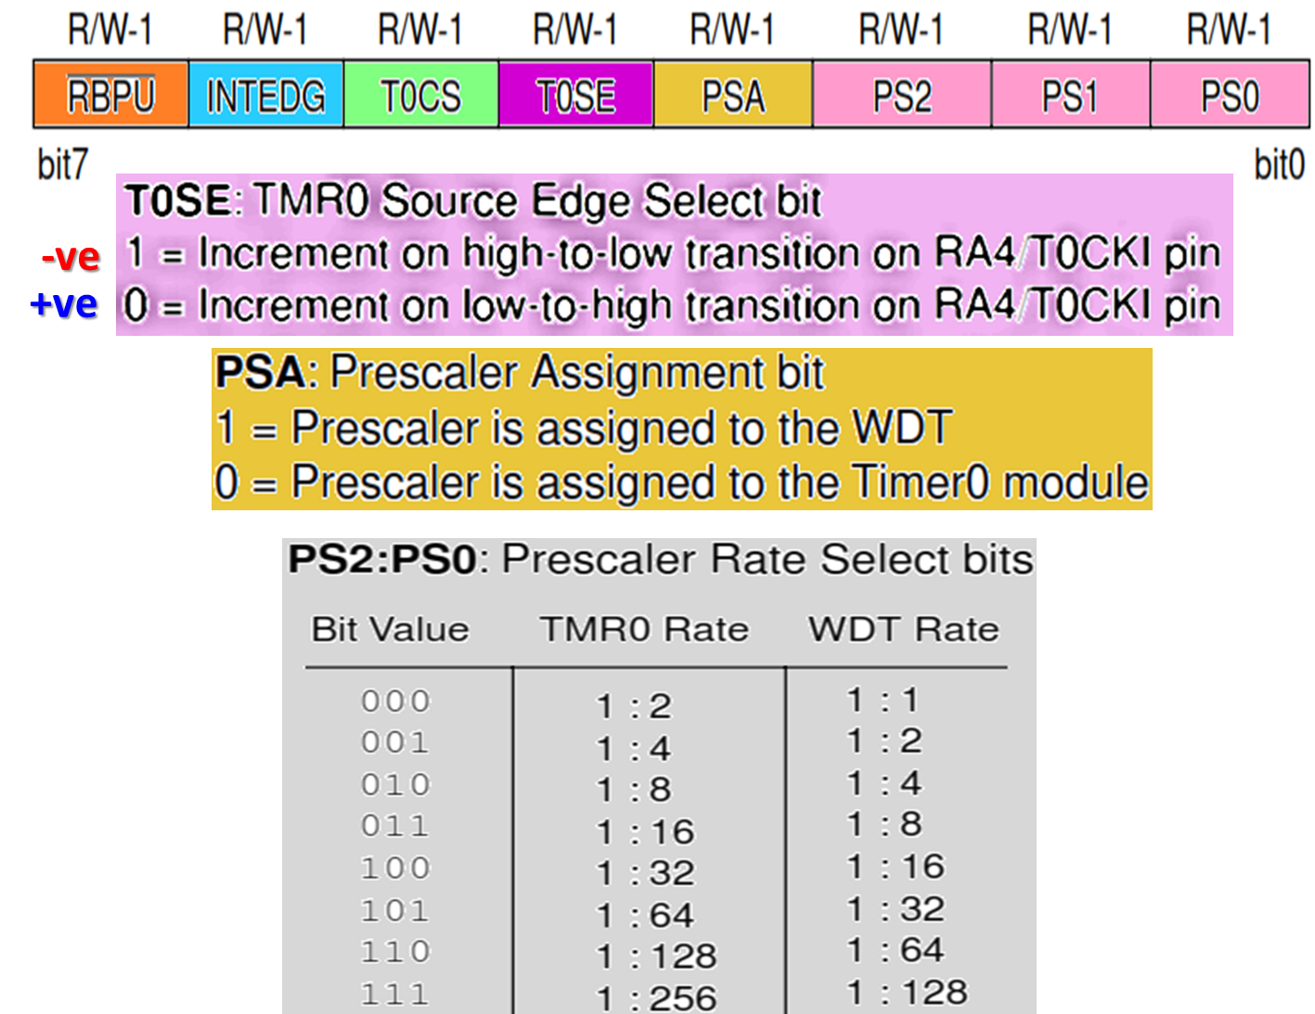
Timers

Slide 32
Timer 1
READABLE/WRITEABLE
1,2,4,8 PROGRAMMABLE PRESCALAR
INTERNAL OR EXTERNAL CLOCK SET
EXTERNAL CLOCK CAN BE SYNC OR NON SYNC
INTERRUPT OVERFLOW FROM 00 TO FFFF
SECOND CRYSTAL
REGISTER- TMR1L,TMR1H,T1CON,PIR1,PIE1

Slide 33
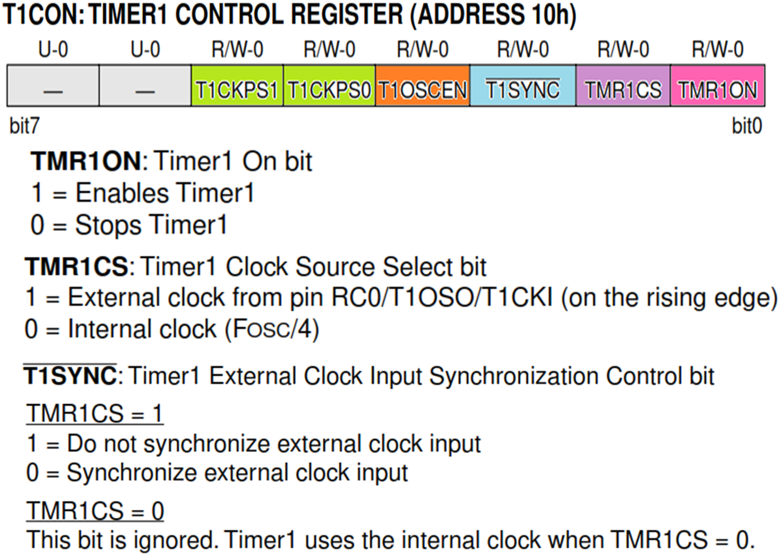
Timer 1

Slide 34
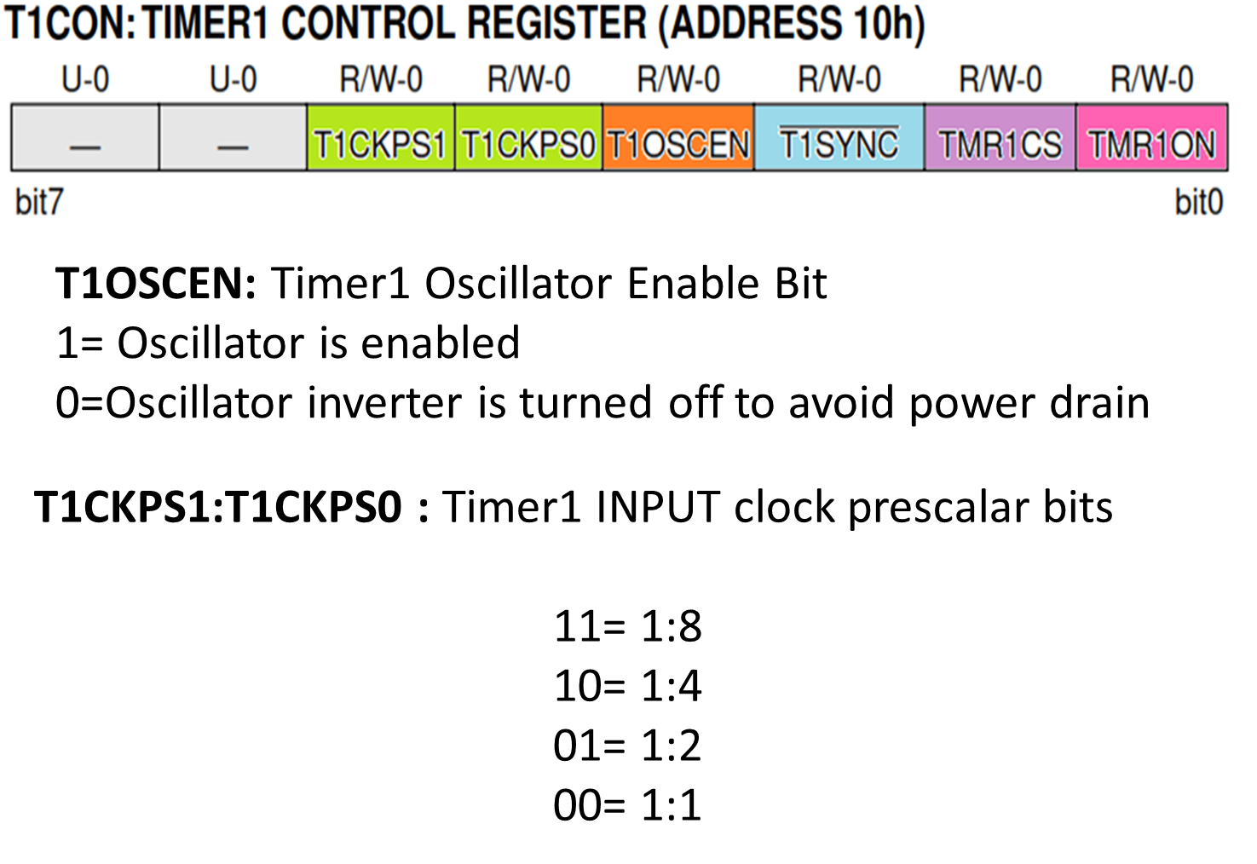
Timer 1

Slide 35
Timer 2
8-bit timer with Prescaler and Postscaler
TMR2 can be used as – PWM
TMR2 register is R/W – cleared on any device reset.
Timer2 module has an 8-bit period register PR2
Timer2 increments from 00h till reaches PR2
PR2 is initialized to FFh upon reset
REGISTER- TMR2,T2CON,PR2,PIR1,PIE1

Slide 36
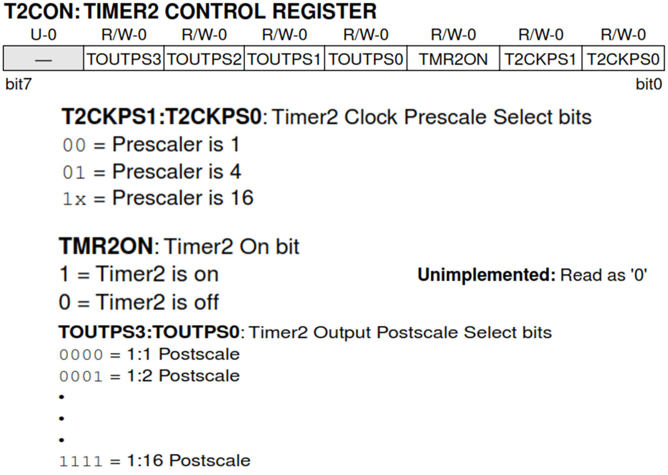
Timer 2

Slide 37
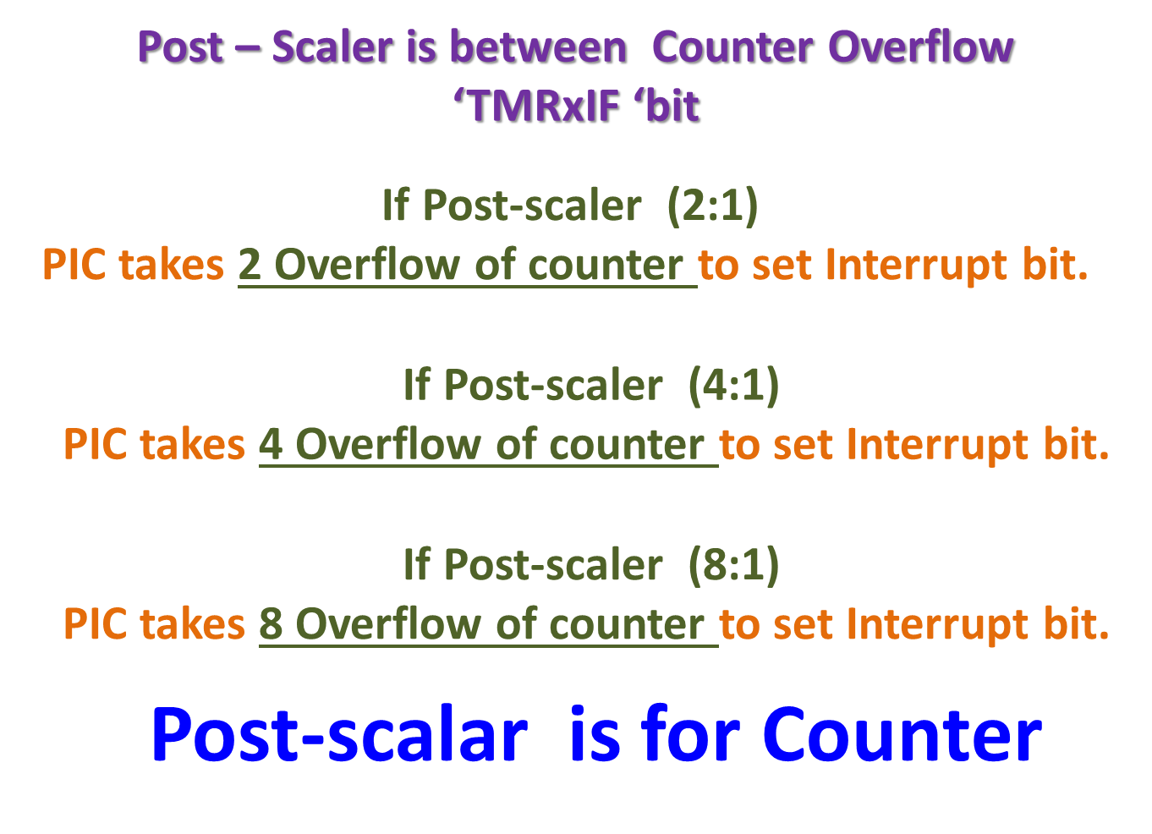
Post -Scaler

Slide 38
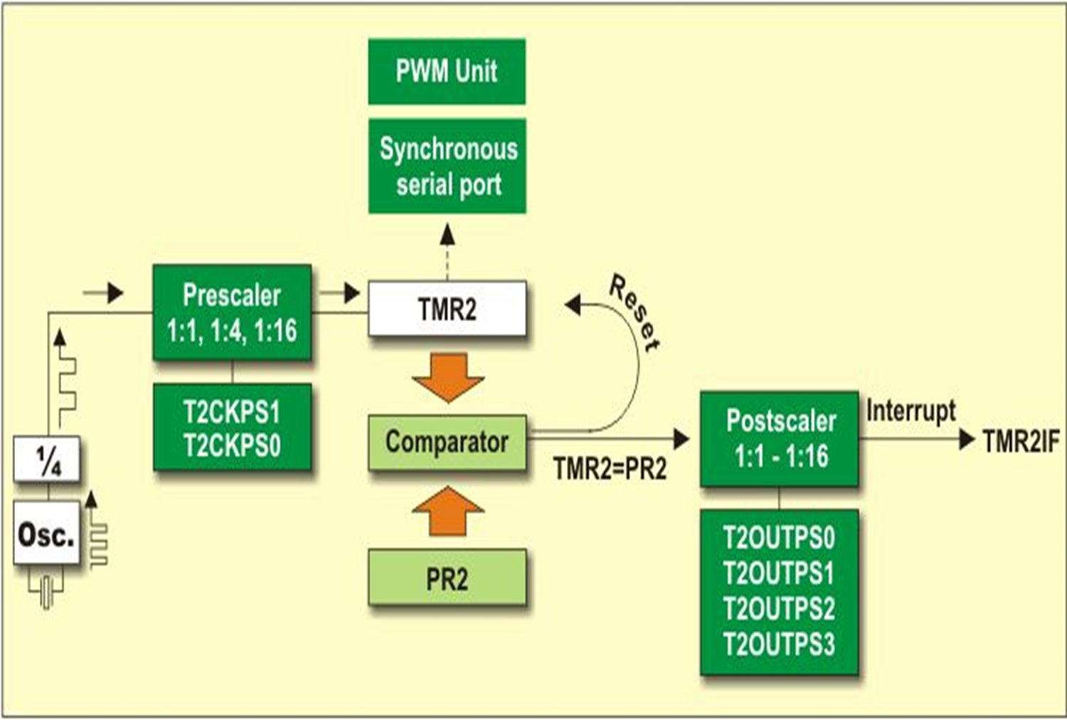

Slide 39
PWM
Pulse Width Modulation, or PWM, is a technique for getting analog results with digital means.
Digital control is used to create a square wave, a signal switched between on and off. This on-off pattern can simulate voltages in between the full Vcc of the board (e.g., 5 V on Uno) and off (0 Volts) by changing the portion of the time the signal spends on versus the time that the signal spends off.
The duration of "on time" is called the pulse width.
To get varying analog values, you , or that pulse width is changed or modulated. If this on-off pattern is repeated fast enough with an LED for example, the result is as if the signal is a steady voltage between 0 and Vcc controlling the brightness of the LED.

Slide 40
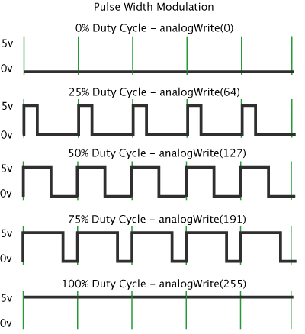
PWM
In the graphic, the green lines represent a regular time period. This duration or period is the inverse of the PWM frequency.
In other words, with Arduino's PWM frequency at about 500Hz, the green lines would measure 2 milliseconds each.
A call to analogWrite() is on a scale of 0 - 255, such that analogWrite(255) requests a 100% duty cycle (always on), and analogWrite(127) is a 50% duty cycle (on half the time) for example.

Slide 41
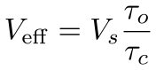
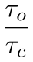
PWM: Pulsed with modulation
PWM simulates DC voltage control for slow loads
The effective voltage is
is called the duty cycle

Slide 42
Arduino PWM commands
Configure the output pin:
Set the duty cycle
The duty cycle is an 8 bit value:
0 ≤ duty_cycle ≤255
PWM_pin = ... ; // one of 3, 5, 6, 9, 10, 11
void setup() {
pinMode( PWM_pin, OUTPUT);
}
void loop() {
int duty_cycle = 150; // between 0 and 255
analogWrite( PWM_pin, duty_cycle );
}

Slide 43
PWM - A practical trial
Once you get this example running, grab your arduino and shake it back and forth.
What you are doing here is essentially mapping time across the space.
To our eyes, the movement blurs each LED blink into a line. As the LED fades in and out, those little lines will grow and shrink in length. Now you are seeing the pulse width.

Slide 44
Types of Arduino Sensors - Shields
HC- SR04 Ultrasonic Module
IR Infrared Obstacle Avoidance sensor
Soil Hygrometer Detection Module
Soil Moisture Sensor
Microphone sensor
Digital Barometric Pressure Sensor
Photoresistor sensor
Digital thermal sensor – Temperature sensor
Rotary Encoder Module
MQ-2 Gas sensor
SW-420 Motion sensor
Humidity and Rain Detection sensor
Passive Buzzer Module
Speed sensor Module
IR Infrared Flame Detection sensor
5V 2- Channel Relay module
Breadboard Power Supply Module 3.3V
HC- SR501 Pyroelectric Infrared Sensor
Accelerometer Module
DHT11 Temperature and Humidity sensor
RF 433MHz Transmitter/Receiver

Slide 45
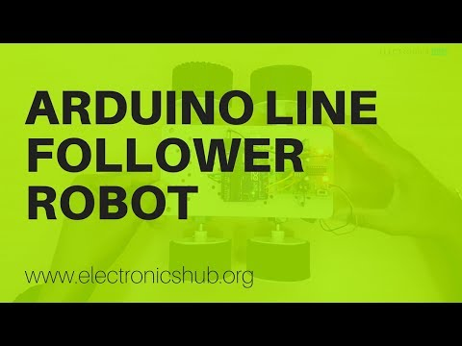
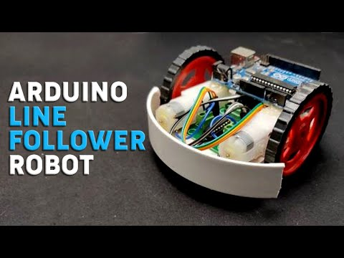
Line Following Robot - Online resources
https://www.electronicshub.org/arduino-line-follower-robot/
https://www.instructables.com/Line-Follower-Robot-PID-Control-Android-Setup/
https://circuitdigest.com/microcontroller-projects/arduino-uno-line-follower-robot

Slide 46
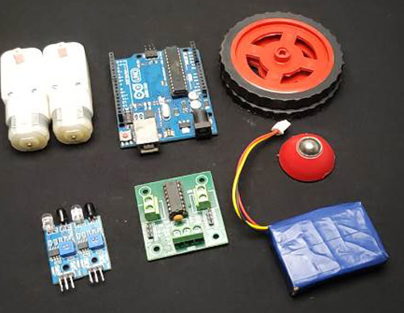
LFR - Components
Arduino Uno - 1Nos
L293D motor driver- 1Nos
IR sensor module -2 Nos
7.4 or 9V battery -1 Nos
Battery Operated (BO) motors - 2 Nos
Motor wheel - 2 Nos
Castor wheel - 1 Nos
Hobby robot chassis - 1 Nos
Jumper Wires
Screws

Slide 47
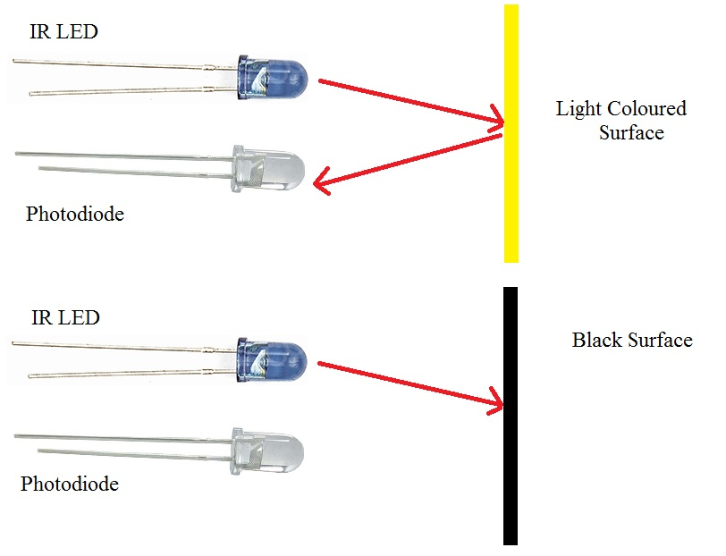
Line Follower Robot
Line Follower Robot (LFR) is a simple autonomously guided robot that follows a line drawn on the ground to either detect a dark line on a white surface or a white line on a dark.
Line follower robot (LFR) follows a line, and in order to follow a line, robot must detect the line first.
Implement the line sensing mechanism in a LFR - We all know that the reflection of light on the white surface is maximum and minimum on the black surface because the black surface absorbs maximum amount of light and doesn’t reach the photodiode.This property of light is used to detect the line.

Slide 48
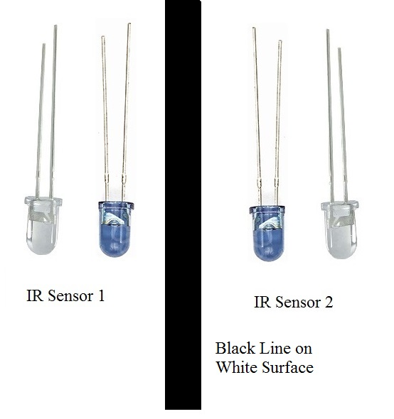
Line Follower Robot
To detect light, either LDR (light-dependent resistor) or an IR sensor can be used. The IR sensor has higher accuracy. To detect the line, two IR sensors are placed one on the left and other on the right side of the robot as marked in the diagram below. We then place the robot on the line such that the line lies in the middle of both sensors.

Slide 49
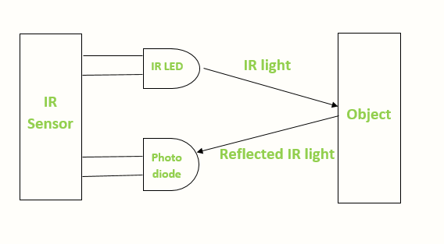
Line Follower Robot
Infrared sensors consist of two elements, a transmitter and a receiver. The transmitter is basically an IR LED, which produces the signal and the IR receiver is a photodiode, which senses the signal produced by the transmitter. The IR sensors emits the infrared light on an object, the light hitting the black part gets absorbed thus giving a low output but the light hitting the white part reflects back to the transmitter which is then detected by the infrared receiver, thereby giving an analog output. Using the stated principle, we control the movement of the robot by driving the wheels attached to the motors, the motors are controlled by a microcontroller.
More on IR Sensor: https://robu.in/ir-sensor-working/#:~:text=IR%20sensor%20is%20an%20electronic,some%20form%20of%20thermal%20radiation.

Slide 50
Line Follower Robot - Movements
A typical line follower robot has two sets of motors, left and right motor.s Both motors rotate on the basis of the signal received from the left and the right sensors respectively. The robot needs to perform 4 sets of motion which includes
moving forward,
turning left,
turning right and
coming to a halt.
When the robot moves forward, both the sensors wait for the line to be detected. For example, if the IR Sensor 1 detects the black line, it means that there is a right curve (or turn) ahead.
Arduino UNO detects this change and sends signal to motor driver accordingly. In order to turn right, the motor on the right side of the robot is slowed down using PWM, while the motor on the left side is run at normal speed.

Slide 51
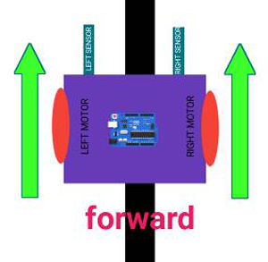
Line Follower Robot - Moving Forward
I n this case, when both the sensors are on a white surface and the line is between the two sensors, the robot should move forward, i.e., both the motors should rotate such that the robot moves in forward direction (actually both the motors should rotate in the opposite direction due to the placement of motors in our setup. But for the sake of simplicity, we will call the motors rotating forward.)

Slide 52
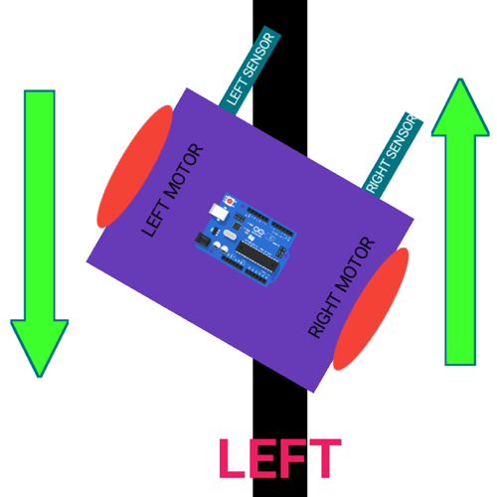
Line Follower Robot - Turning Left
In this case, the left sensor is on top of the dark line, whereas the right sensor is on the white part, hence the left sensor detects the black line and gives a signal, to the microcontroller.
Since, signal comes from the left sensor, the robot should turn to the left direction. Therefore, the left motor rotates backwards and the right motor rotates in forward direction. Thus, the robot turns towards left side.

Slide 53
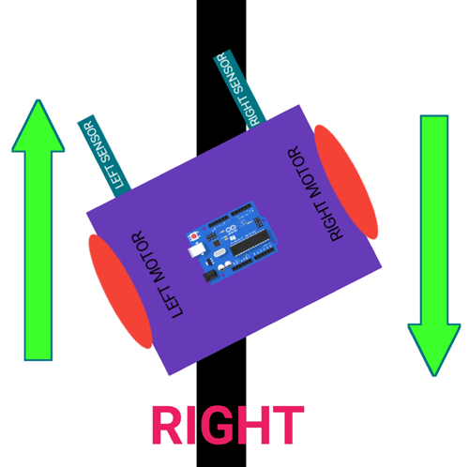
Line Follower Robot
This case is similar to the left case, but in this situation only the right sensor detects the line which means that the robot should turn in the right direction.
To turn the robot towards the right direction, the left motor rotates forward and the right motor rotates backwards and as a result, the robot turns towards the right direction.

Slide 54
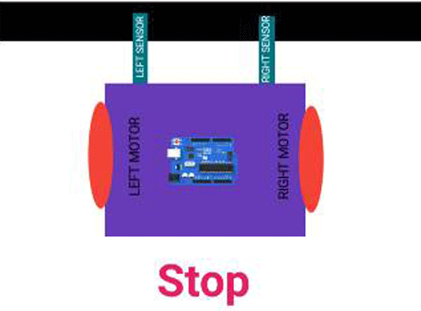
Line Follower Robot - Stopping
In this case, both the sensors are on top of the line and they can detect the black line simultaneously, the microcontroller is fed to consider this situation as a process for halt.
Hence, both the motors are stopped, which causes the robot to stop moving.

Slide 55
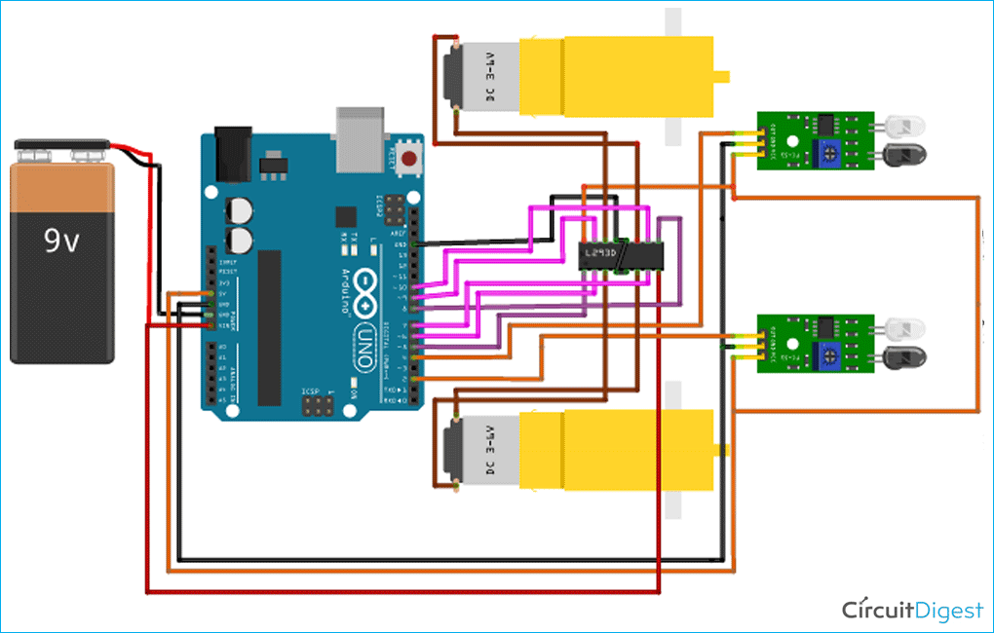
Line Follower Robot

Slide 56
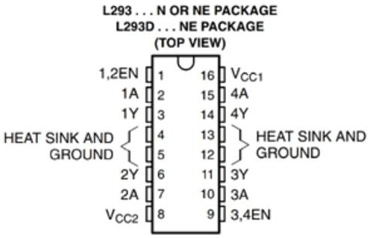
LFR - Why a Motor Driver?
The output signal of an Arduino is not sufficient to drive the motor,
to drive the motor as required as the motors are required to rotate in both directions
Be able to supply sufficient current to drive the motor.
Using a L293D motor driver which is a dual h bridge motor driver and is sufficient for 2 motors.
The L293D has 16 pins, the pinout of L293D is shown in the below diagram.

Slide 57
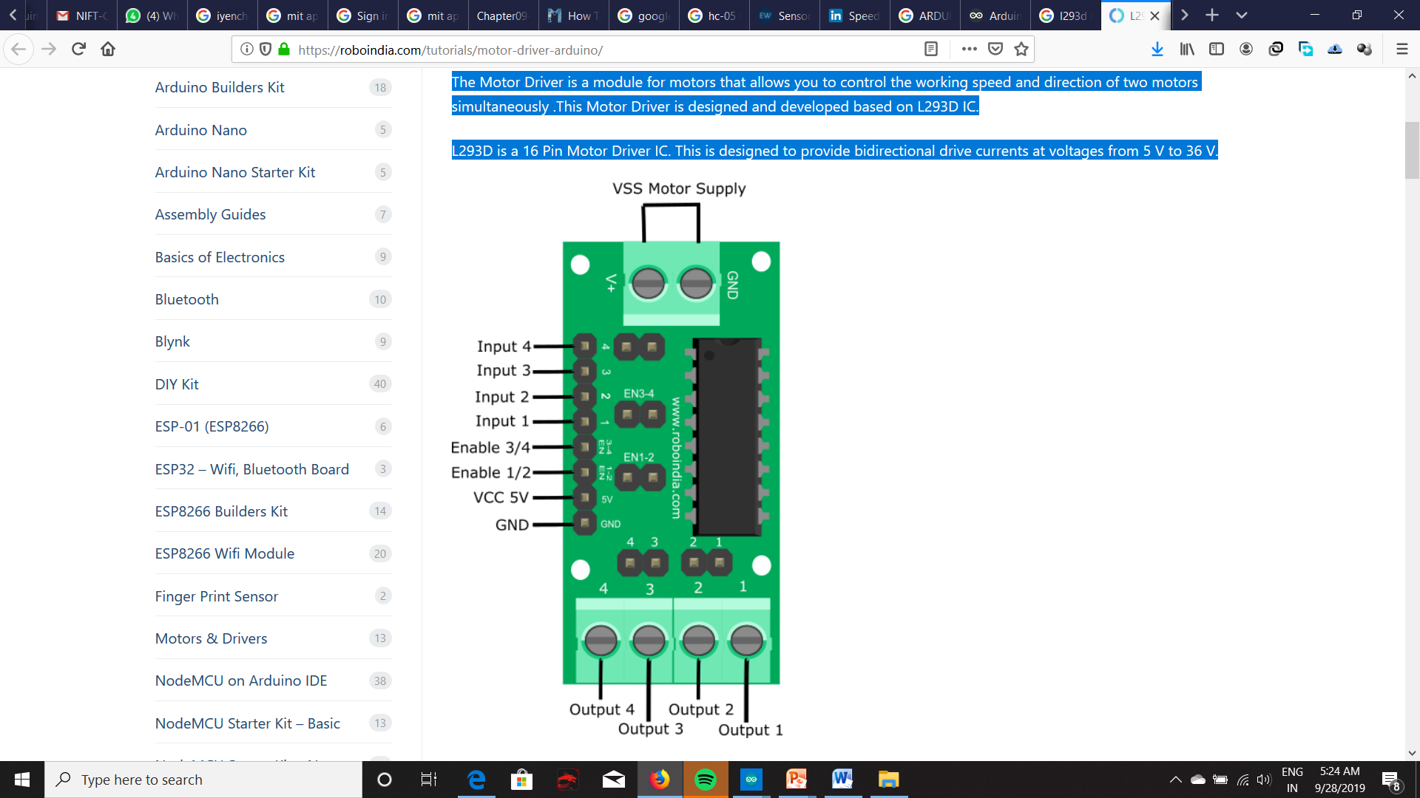
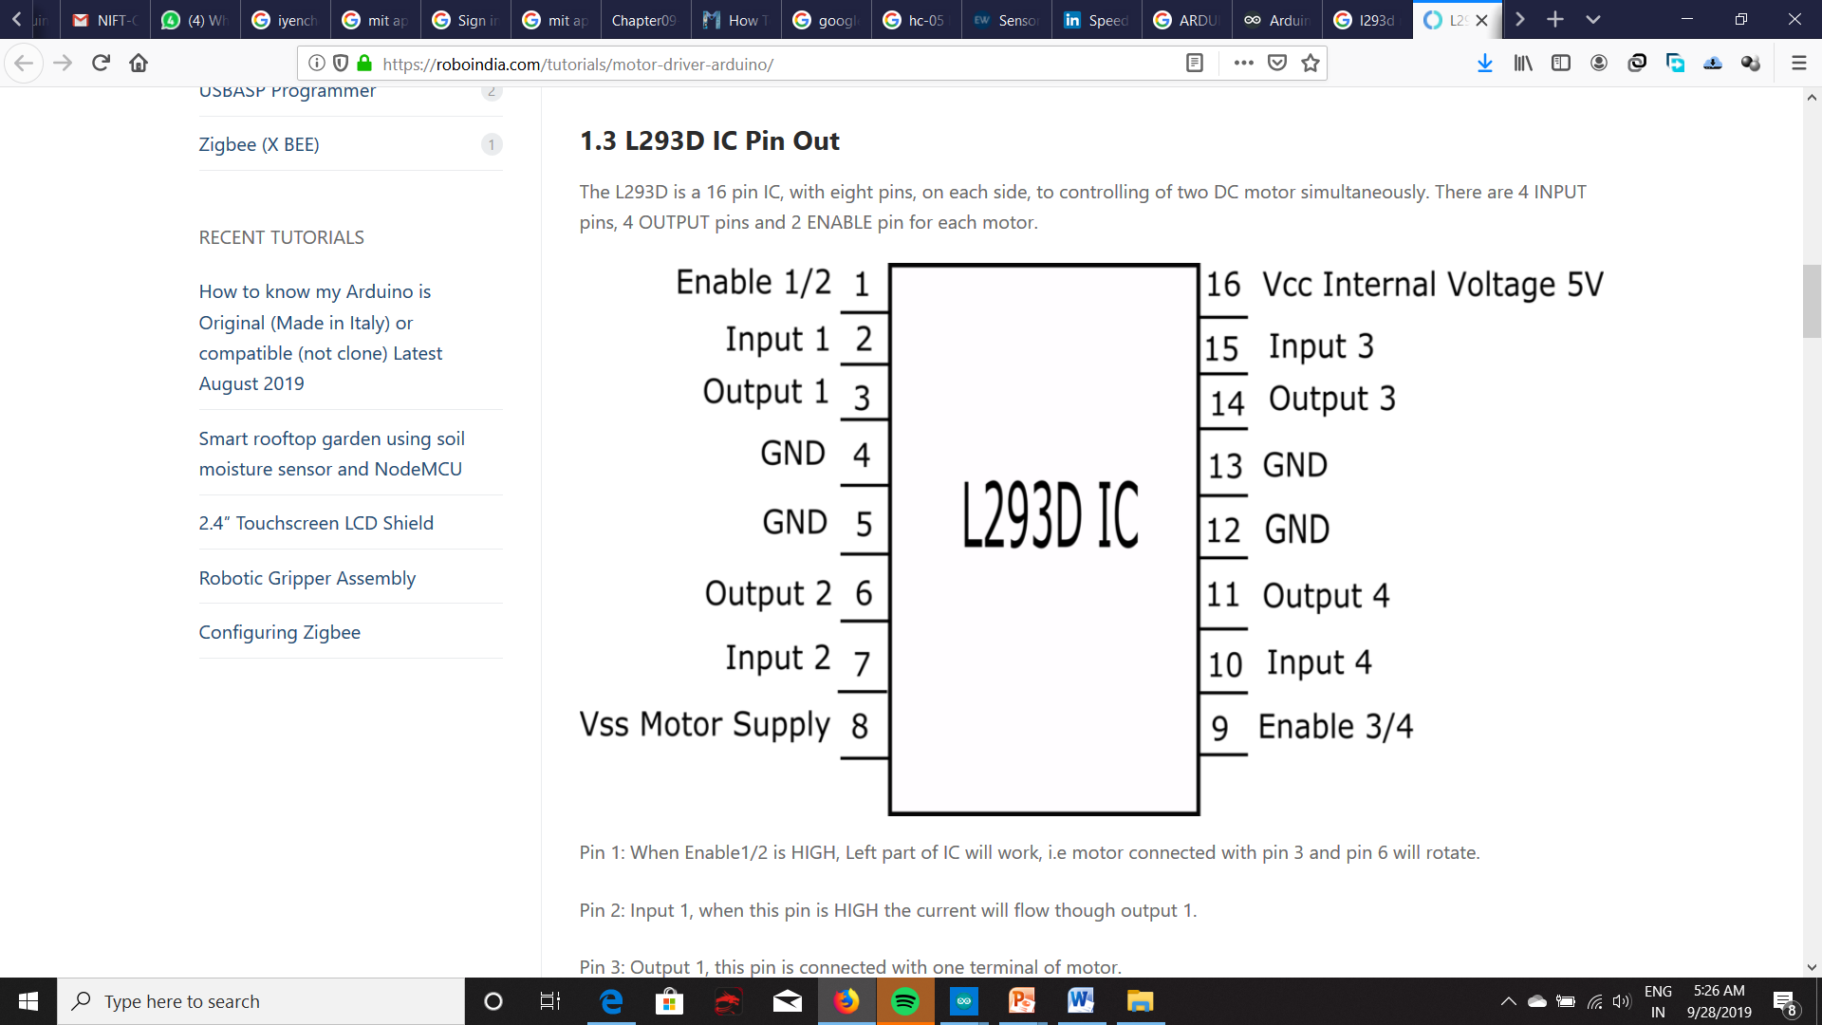
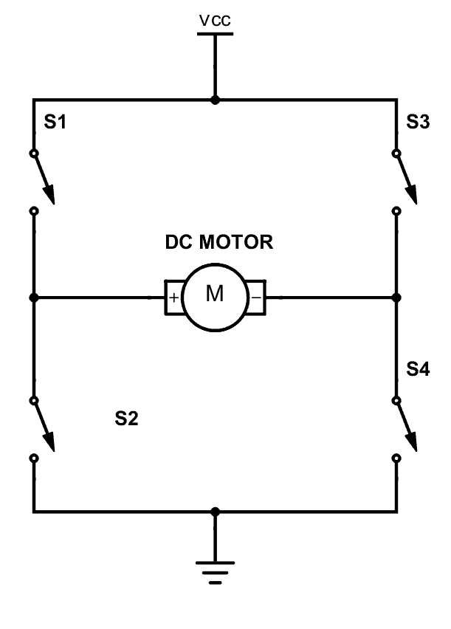
L293D
Pin 1: When Enable1/2 is HIGH, Left part of IC will work, i.e motor connected with pin 3 and pin 6 will rotate.
Pin 2: Input 1, when this pin is HIGH the current will flow though output 1.
Pin 3: Output 1, this pin is connected with one terminal of motor.
Pin 4/5: GND pins

Slide 58
LFR - Connection of motor driver pins
Pin number 1 and 9 are the enable pins, we connect these two pins to a 5v input to enable the motor.
Pin number 1A, 2A, 3A, and 4A are the control pins.
For eg. The motor will turn to the right if the pin 1A goes low and 2A goes high, and the motor will turn to the left if 4A goes low and 3A high. So, these pins are connected to the output pins of the decoder.
Pins 1Y, 2Y, 3Y, and 4Y are the motor connection pins.
Note: Vcc2 is the motor driving voltage pin, and only used if when using a high voltage motor.

Slide 59
L293D CONNECTION
Arduino Pins L293D Pins DC MOTOR
D8 ———-> A1
D9 ———-> A2
D10 ———-> B1
D11 ———-> B2
A3(PWM) ———-> EN A
A5(PWM) ———-> EN B
5V ———-> VCC
GND ———-> GND

Slide 60
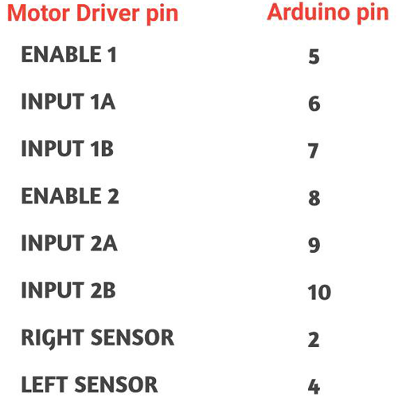
LFR - Pin connection of Arduino Uno with the Motor driver
A 7.4 li-ion battery has been used to power the whole circuit. Any battery type from 6-12 volts can be used.
To move the robot, we need to use motors with low RPM but torque high enough to carry the weight of the robot. Therefore, two 60 RPM 6V Battery Operated, geared motors have been chosen for this robot .

Slide 61
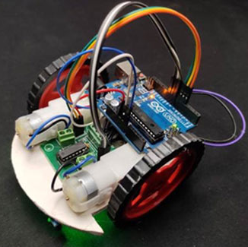
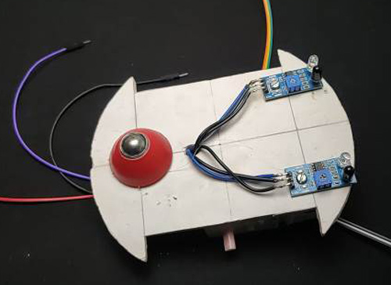
Line Follower Robot -Assembly

Slide 62
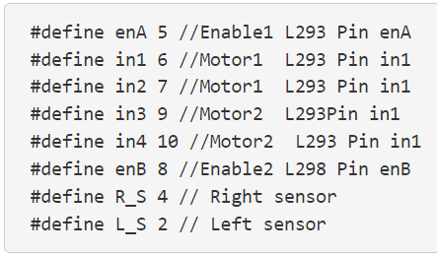
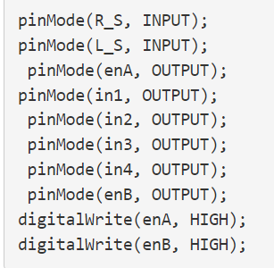
Line Follower Robot - Code
Define Section
Start with motoring the driver pins and sensor pins.
In the loop section,
declare the pin modes of each pin.
read the output of IR sensors, and so pins are defined as an input.
The motor needs to be driven by the Arduino, thus defining the motor driver pins as output.
Finally, enable pin to high.

Slide 63
Line Follower Robot - Code
Moving forward:
In this case, if Right Sensor and Left Sensor are on top of white colour then the robot should move in the forward direction, so we call the forward function.
(Note : here 0 means output of IR sensor is high as the sensor is on white surface)

Slide 64
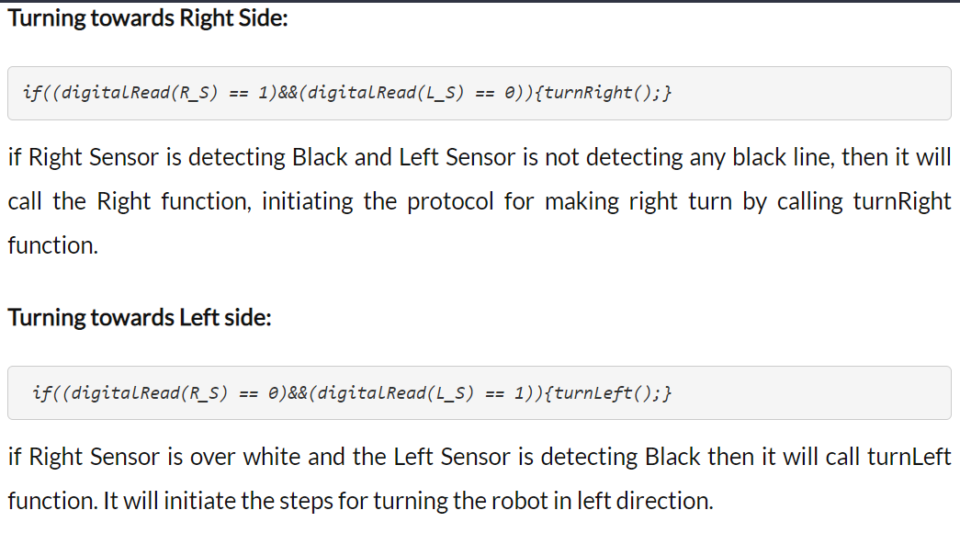
Line Follower Robot - Code

Slide 65
Line Follower Robot - Code
Stopping the robot
If the Right Sensor and Left Sensor are on the Black color then it calls the Stop function. In this case, the robot will come to a complete halt.

Slide 66
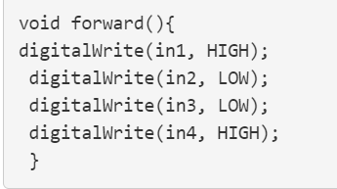
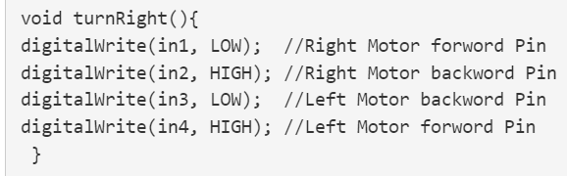
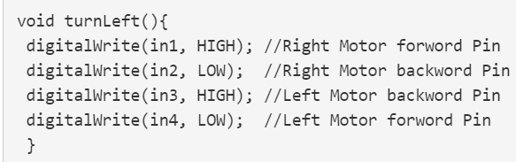
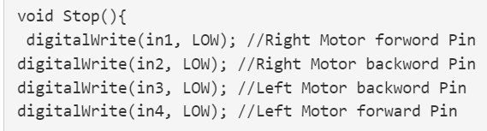
Line Follower Robot - Code
Now we upload the code to the Arduino using the Arduino IDE!!

Slide 67

GPS

Slide 68
GPS
GPS stands for Global Positioning System and used to detect the Latitude and Longitude of any location on the Earth, with exact UTC time (Universal Time Coordinated). This device receives the coordinates from the satellite for each and every second, with time and date. GPS offers great accuracy and also provides other data besides position coordinates.
GPS is a very useful device and very commonly used in mobile phones and other portable devices for tracking the location. It has very wide range of applications in every field from calling the taxi at your home to track the altitude of airplanes.

Slide 69
GPS - How it works
GPS is a navigation technology which, by use of satellites, tells the precise information about a location. Basically a GPS system consists of group of satellites and well developed tools such as receiver. The system, however, should comprise at least four satellites. Each satellite and the receiver are equipped with stable atomic clock. The satellite clocks are synchronised with each other and ground clocks. GPS receiver also has a clock but it is not synchronized and is not stable (less stable). Any deviation of actual time of satellites from ground clock should be corrected daily.
Four unknown quantities (three coordinates and clock deviation from satellite time) are required to be computed from the synchronized network of satellites and the receiver. The work of the GPS receiver is to receive signals from the network of satellites to compute three basic unknown equations of time and position.

Slide 70
GPS - How it works
A GPS signal includes a pseudorandom codes and time of transmission and satellite position at that time.
The signal broadcasted by GPS is also called carrier frequency with modulation.
Further, a pseudorandom code is a sequence of zeros and ones. Practically, the receiver position and the offset of receiver clock relative to receiver system time are computed simultaneously, using the navigation equations to process time of flight (TOFs).
TOF is the four values that the receiver forms using time of arrival and time of transmission of the signal. The location is usually converted to latitude, longitude and height relative to geoids (essentially, mean sea level). Then the coordinates are displayed on the screen.

Slide 71
GPS - How it works
GPS satellites rotate all around the earth two times in a day. It revolves around in a very accurate course and sends out indication and information to the earth. The receivers of GPS get all the information and apply triangulation to discover the accurate location of the user. Fundamentally, the receiver of GPS contrasts the duration at which a signal was spread by a satellite and allots the time it was received. The time difference formulates how far the receiver is away from the satellites of the GPS. It measures the exact distance with few more satellites and the receiver determines the position of the user and displays it on the map of the electronic appliance.
The receiver must be locked to the signal with at least three satellites to produce a two dimensional position and also tracks the movement of the user. By using four or more satellites, the receiver can determine the three dimensional position of the user which consists of altitude, latitude and longitude. After determining the position of user, the GPS unit calculates other information such as speed, bearing, track, distance, destination, sunrise, and sunset time.

Slide 72
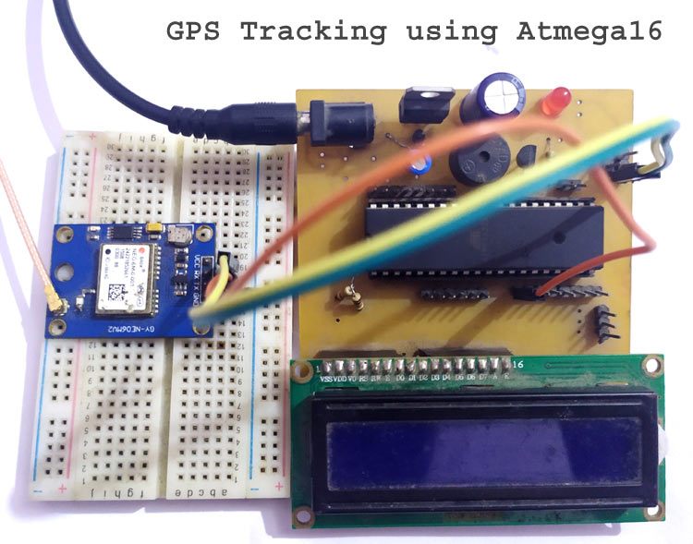
GPS

Slide 73
GPS - Components needed
Arduino Board,
GPS receiver Module SKG13BL
computer and
12v/3.3v adaptor for power supply.
Before connecting it to the computer, we first need to remove the Arduino IC (Atmega chip) from the Arduino Board, as we only need the serial circuitry of the Arduino. This is called the Gateway mode. Removing the IC is shown in below figures:

Slide 74
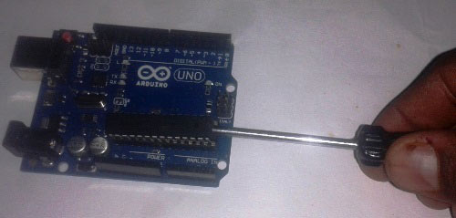
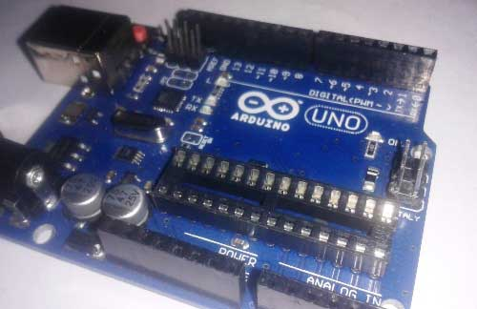
GPS

Slide 75

GPS
Now do the connection like given in below picture:
GPS TX pin to Digital PIN 1 of Arduino (TXD)
GPS Ground Pin to GND PIN of Arduino
GPS Power (3.3v) Pin to 3.3v PIN of Arduino

Slide 76

GPS
After connections, connect the USB cable to the computer, open your Arduino IDE software in computer, select com port and open serial monitor to listen the serial port and Power up the Arduino and GPS module.

Slide 77

GPS -When not in range

Slide 78

GPS - when within range

Slide 79
GPS
In serial Window, you can see some sentences that start from $ sign. These are NMEA sentences. GPS module sends the Real time tracking position data in NMEA format NMEA format consist several sentences, in which four important sentences are given below.
(NMEA is a standard data format supported by all GPS manufacturers, much like ASCII is the standard for digital computer characters in the computer world. The purpose of NMEA is to give equipment users the ability to mix and match hardware and software)
$GPGGA: Global Positioning System Fix Data
$GPGSV: GPS satellites in view
$GPGSA: GPS DOP and active satellites
$GPRMC: Recommended minimum specific GPS/Transit data
These strings contain many GPS parameters like: Time, Date, Longitude, Latitude, speed, no. of satellites in used, altitude and many other things.

Slide 80

GPS
When we use GPS module for tracking any location, we only need coordinates and we can find this in $GPGGA string. Only $GPGGA (Global Positioning System Fix Data) String is mostly used in programs and other strings are ignored. This string consist fix data as below:
$GPGGA,104534.000,7791.0381,N,06727.4434,E,1,08,0.9,510.4,M,43.9,M,,*47
$GPGGA,HHMMSS.SSS,latitude,N,longitude,E,FQ,NOS,HDP,altitude,M,height,M,,checksum data

Slide 81

GPS
And $GPRMC string mainly contains velocity, time, date and position
$GPRMC,123519.000,A, 7791.0381,N, 06727.4434,E,022.4,084.4,230394,003.1,W*6A
$GPRMC,HHMMSS.SSS,A,latitude,N,longitude,E,speed,angle,date,MV,W,CMD

Slide 82
GPS - NMEA sentence information
National Marine Electronics Association [NMEA]
http://aprs.gids.nl/nmea/

Slide 83

Interfacing Seven Segment Display with Arduino

Slide 84

7 segment LED display
Seven-segment displays are available in various sizes and colours. They are available from 0.28 inches to 18 inches, and even bigger sizes are available for industrial usage. The most commonly used display size is 0.56 inches.

Slide 85


7 segment LED display

Slide 86
7 segment LED display - 2 types
Seven segment displays are mainly categorized into two types,
Common Cathode (CC) and
Common Anode (CA).
This classification is done based on which pin of the LEDs is connected to the common pin. If the Anodes of these LEDs are connected together, then it’s called Common Anode displays. And if the Cathode is connected together, then they are called Common Cathode displays.

Slide 87

Common Cathode (CC) display
In a Common Cathode (CC) display, all the cathodes of the LEDs are connected together to the common pin. This common pin is then connected to the ground rail of the circuit. The individual LEDs can be activated by applying a high pulse or a logic 1 signal to the corresponding pin.
The common pin is connected to the GND and each data pin is connected to VCC through a switch. When a switch is pressed, the corresponding LED will be forward biased, and the segment will light up. On the right side, you can see the simplified diagram of a seven-segment display.

Slide 88

Common Anode (CA) display
In a Common Anode (CA) display, all the anodes of the LEDs are connected together to the common pin. This common pin is then connected to the positive rail of the circuit. The individual LEDs can be activated by applying a low pulse or a logic 0 signal to the corresponding pin.
The common pin is connected to the VCC and each data pin is connected to GND through a switch. When a switch is pressed, the corresponding LED will be forward biased, and the segment will light up. On the right side, you can see the simplified diagram of a seven-segment display.

Slide 89

Displaying Numbers
To display a number or pattern, we must activate the corresponding pins with the appropriate signal, i.e. for Common Cathode display Logic 0 or LOW and for Common Anode display Logic 1 or HIGH. By this method, we can display various digits from 0 to 9. Here is the character map for each character.
https://circuitdigest.com/sites/default/files/inlineimages/u4/Seven-Segment-Display-Working.mp4

Slide 90

Displaying Numbers

Slide 91

7 segment LED display
Even though the seven-segments are designed to display numbers, we can also display alphabets using them. Here is the truth table for the alphabet.

Slide 92

Connecting with Arduino
Connect either of the common pins (seven-segment pin 3 or 8) to the ground. And connect the rest of the pins to D2 to D9 of the Arduino through a current limiting resistor, as per the connection diagram. Just like driving an LED, it is preferable to use these current limiting resistors to increase the display life. Choose these values depending on the display colour and size. Here we will be using a 330 ohms resistor which will provide around 10mA current for the LEDs.

Slide 93

7 segment LED display circuit

Slide 94
7 segment LED display
Install several Arduino libraries and these can be done directly via the library manager.
To install the libraries, navigate to the Arduino IDE > Sketch > Include Library > Manage Libraries… Wait for the Library Manager to download the libraries index and update the list of installed libraries.
Then search for SevSeg and install the SevSeg library by Dean Reading.
Once you have installed the library, create a new sketch and copy our Arduino example code to it.

Slide 95

7 segment LED display
- count from 0-9 and reset back to 0

Slide 96
Explanation of the sketch
In the setup() function we initialize the SevSeg library. To initialize the library the following variables are used.
The first one is numDIgits; this variable indicates the number of displays connected. In this example only one display is used, so this variable is 1.
The second variable is digitPins; this variable represents the Arduino pins connected to the common pins of multi-segment displays. Since there is only one segment display, we connect the common pin to the ground, and leave this blank.
The Variable segmentPins; contain the Arduino pin numbers to which the segment pins are connected. The pin connection is in the following order a, b, c, d, e, f, g, dp.
displayType indicates the display type, whether common anode or common cathode.
And the resisitorsOnSegment indicates whether the current limiting resistors are connected to the segment pins or the common pin.

Slide 97

Explanation of the sketch
In the loop function, the variable 'i' is counting from 0-9 and displays this value with help of setNumber and refreshDisplay function.
The counting interval is set to 1 second using the delay function.

Slide 98

7 segment LED display
Source: https://circuitdigest.com/microcontroller-projects/interfacing-seven-segment-display-with-Arduino

Slide 99
7 segment LED display

Slide 100
7 segment LED display

Slide 101
7 segment LED display

Slide 102
7 segment LED display

Slide 103
Resources
https://www.sanfoundry.com/1000-arduino-questions-answers/
https://robu.in/ir-sensor-working/#:~:text=IR%20sensor%20is%20an%20electronic,some%20form%20of%20thermal%20radiation.
https://www.electronicshub.org/arduino-line-follower-robot/
https://www.instructables.com/Line-Follower-Robot-PID-Control-Android-Setup/
https://circuitdigest.com/microcontroller-projects/arduino-uno-line-follower-robot

